Slide 1

Intrusion Detection Systems and Honeypots
Welcome! This presentation will delve into the world of intrusion detection systems (IDS) and honeypots, exploring their functionalities, types, advantages, and combined use for robust Cybersecurity.
Masoom Shaikh
24CO1009

Slide 2
What is an Intrusion Detection System?
Definition
Key Role
An intrusion detection system (IDS) is a security system that monitors network traffic for suspicious activity and alerts administrators to potential threats. It acts as a watchdog for your network, constantly analyzing data to detect anomalies and potential intrusions.
The primary function of an IDS is to identify malicious activities like unauthorized access, data breaches, and malware attacks. By detecting these threats, IDS systems allow for prompt response and mitigation of potential damage.

Slide 3

Types of Intrusion Detection Systems
Signature-Based
Anomaly-Based
Signature-based IDS detects threats by comparing incoming traffic to a database of known attack signatures. It relies on per-defined patterns of malicious activity to identify threats.
Tool: Snort
Anomaly-based IDS analyzes network traffic to identify deviations from normal patterns. It looks for unusual behaviors or activities that might indicate malicious intent.
Tool: SolarWinds Security Event (SEM)
Hybrid
Hybrid IDS combines the advantages of both signature-based and anomaly-based approaches, offering a more comprehensive and robust solution.
Tool: Suricate

Slide 4
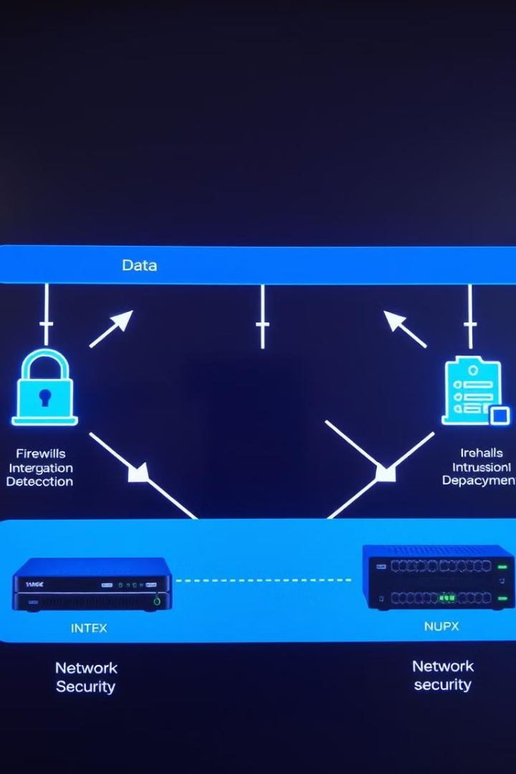



How does an IDS Work?
Monitoring
The IDS constantly monitors network traffic, capturing and analyzing data packets flowing in and out of the network.
Analysis
The IDS applies per-defined rules or anomaly detection algorithms to analyze the captured data. It looks for patterns that indicate suspicious activity.
Alerting
Upon detecting suspicious activity, the IDS alerts administrators through notifications, logs, or visual alarms. It provides detailed information about the detected threats, including their nature and source.

Slide 5
Advantages and Limitations of IDS
Advantages
Limitations
Early threat detection
False positives
Improved security posture
Limited prevention capability
Proactive security measures
Resource intensive

Slide 6



Introduction to Honeypots
1
Deception
2
Attraction
3
Analysis
Honeypots are decoy systems designed to attract attackers and provide valuable insights into their tactics and techniques. They act as a controlled environment for monitoring and analyzing malicious activity. Honeypots lure attackers, allowing security professionals to study their behaviors and gather evidence for potential prosecutions.

Slide 7




Types of Honeypots
High-Interaction
High-interaction honeypots are designed to provide a realistic environment for attackers to explore and interact with. They offer a more comprehensive understanding of attacker techniques but require more resources to maintain.
Low-Interaction
Low-interaction honeypots present a limited set of services or data to attackers, offering a simplified approach to monitoring and analysis. They require less resources but provide less detailed information.
Virtual Honeypots
Virtual honeypots are created within virtualized environments, offering flexibility and scalability. They are easily deployed and can be customized to mimic specific target systems.

Slide 8

Combining IDS and Honeypots for Effective Security
1
Early Warning
IDS provides an early warning system, alerting administrators to suspicious activity on the network.
2
Threat Intelligence
Honeypots offer valuable threat intelligence, providing insights into attacker motivations, techniques, and targets.
3
Proactive Defense
Combining both IDS and honeypots strengthens your security posture, allowing for proactive defense and a deeper understanding of evolving threats.

Slide 9
Thank You!!!

